Slide 1
Safety Analysis and Crime Rate Prediction for the City of Toronto
Research Project Summer 2020

Slide 2
Questions
Do you know the safety of the Toronto regions you live in?
This research provides a new scientific way to measure the crime rate of Toronto regions using PCA and clustering techniques.
Do you know how the safety of your neighborhood will be in future? How data science can help to detect emerging crime hotspots?
This research uses timeseries regression models to project the future crime rate of Toronto regions.

Slide 3
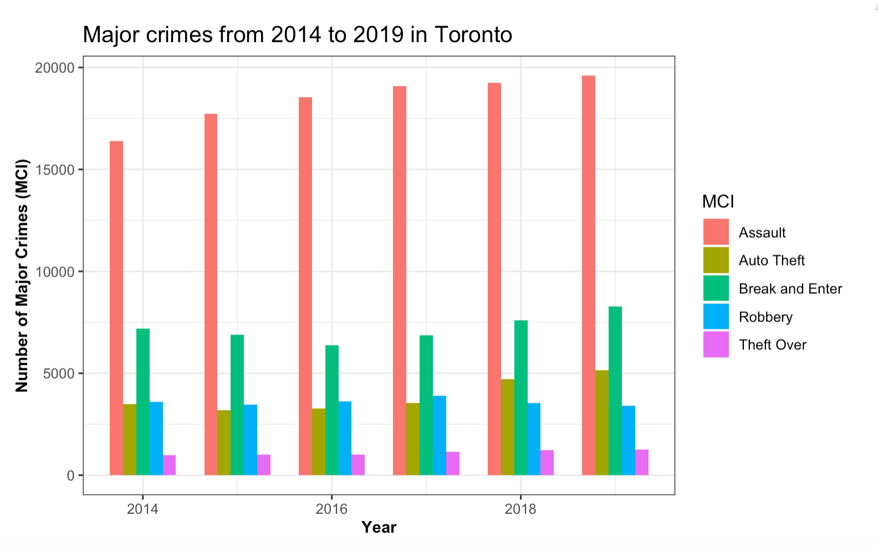
Major Crime Indicator Dataset
MCI dataset shows 5 main categories of crime types for the city of Toronto.
Dataset consists of 206,435 crime records.
Assault, auto theft, and break and enter are dramatically increasing each year while other factors are almost constant.
Assault is the dominant crime during these years.

Slide 4
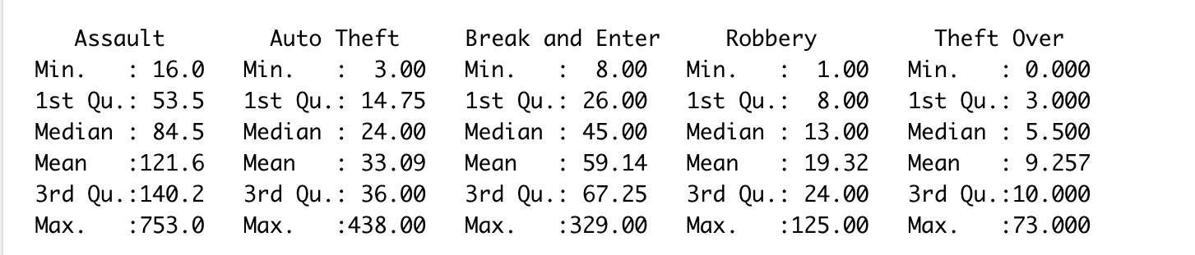
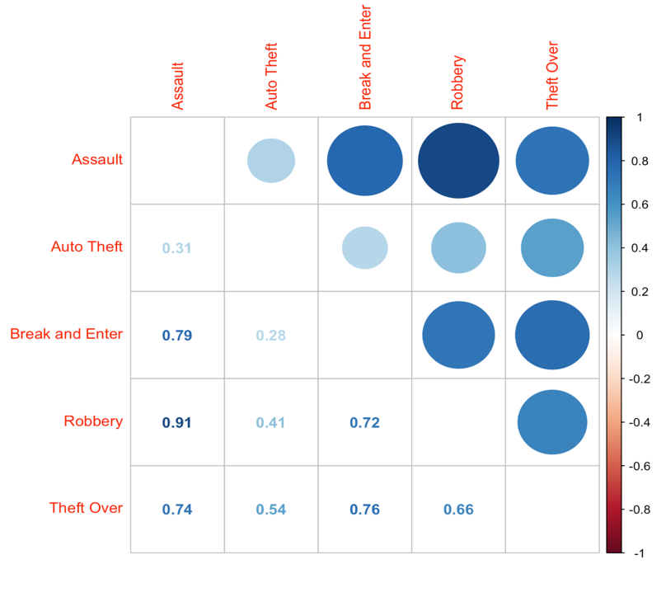
Attributes
Occurrence year
Occurrence month
Neighborhood
MCI (Assault, Auto Theft, Break and Enter, Robbery and Theft Over)
Longitude
Latitude

Slide 5
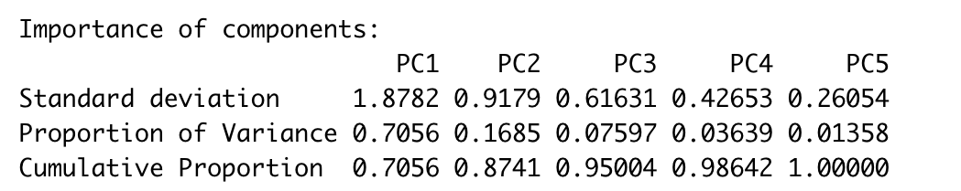
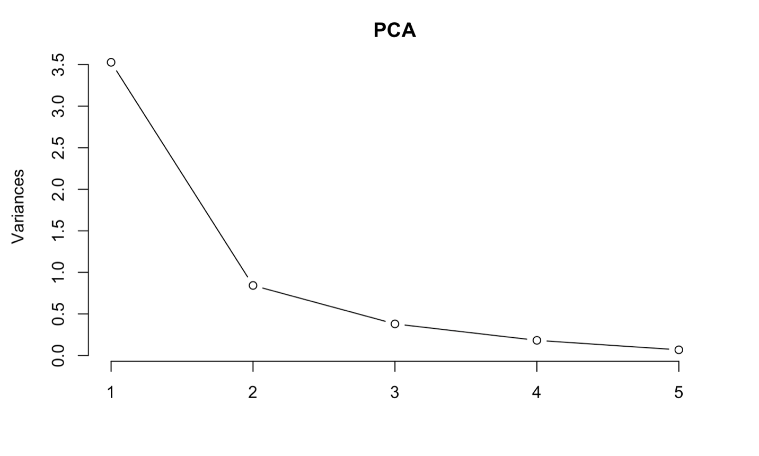
Principal Component Analysis
Reduce dimensionality and redundancy
Help to find the most deviated attributes to the crime analysis.
Produce uncorrelated principal components.
Scree plot shows the elbow of the graph at 2.

Slide 6
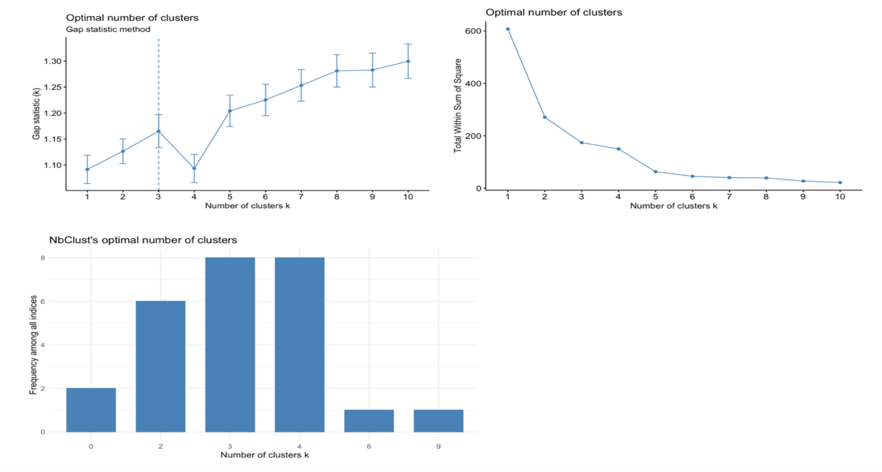
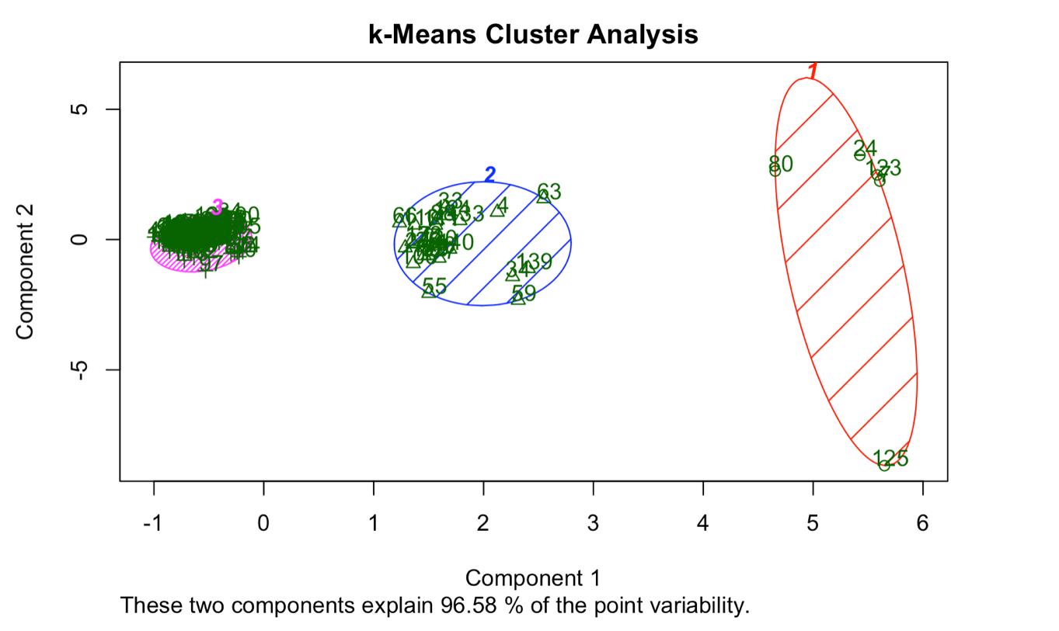
K-Means Clustering
Find optimal number of clusters by:
Elbow method
Gap Statistics
NbClust
What are the top 3 safest places of the city during 2019?
Guildwood
Woodbine-Lumsden
Lambton Baby Point
Gap Statistic, Elbow, and NbClust method is used to find the optimal number of K.

Slide 7
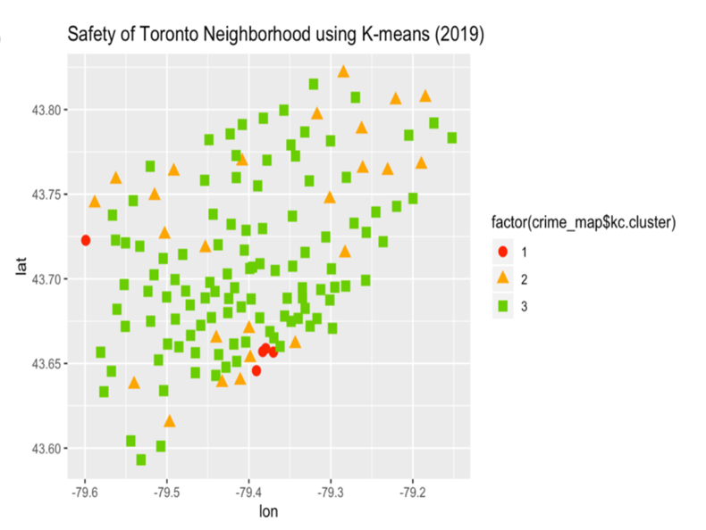
K-Means Clustering
Find optimal number of clusters by:
Elbow method
Gap Statistics
NbClust
What are the top 3 safest places of the city during 2019?
Guildwood
Woodbine-Lumsden
Lambton Baby Point

Slide 8
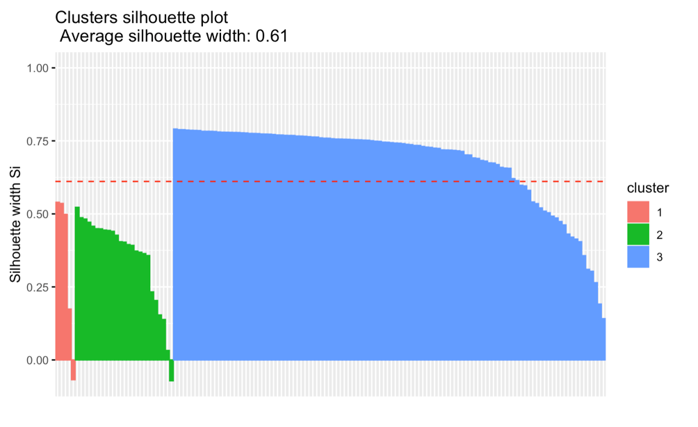
K-Means Validation
within_ss + between_ss = total_ss
Compactness and quality of clustering is measured based on the between_ss / total_ss
Using K = 3 the compactness of clustering is 71.4%.
Other method of validation?
External clustering validation
Silhouette width

Slide 9
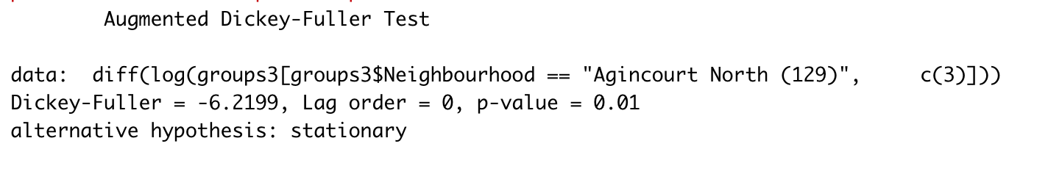
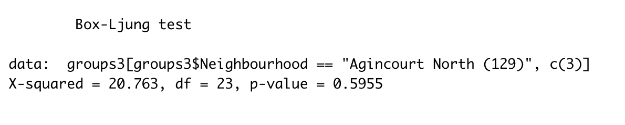
Timeseries Analysis and Regression Models
A timeseries of data is created from 2014 to 2019.
Pre-Tests:
Augmented Dickey-Fuller (ADF)
Ljung Box Test
Time series forecasting has been performed using popular methods such as:
Autoregression (AR)
K-Nearest Neighbors (KNN)
Simple Moving Average (SMA)

Slide 10
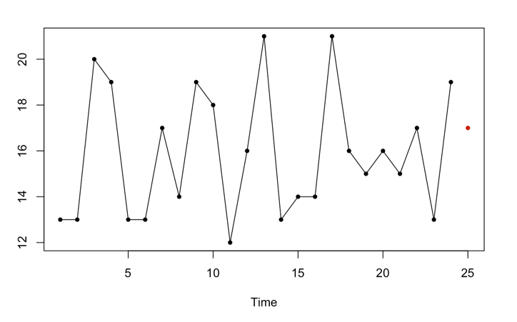
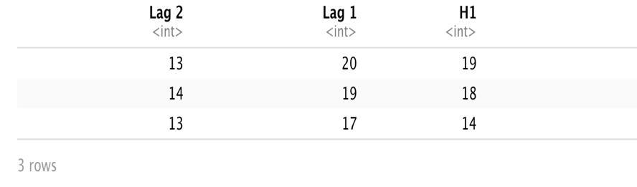
K-Nearest Neighbor (KNN)
The forecast horizon is 1 and selected number of K is 3.
Timeseries forecasted value for assault crime is 17 based on the two previous lags using KNN regression model.
The predicted value is based on data points [13,20], [14,19] and [13,17].

Slide 11
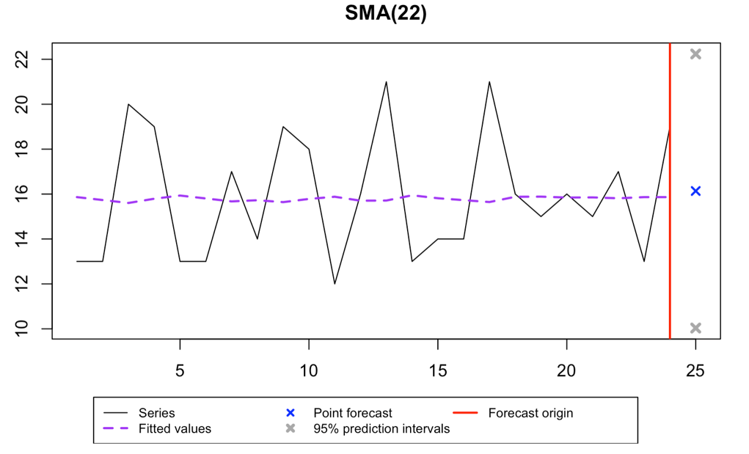
Simple Moving Average (SMA)
SMA forecasts the next data point in a time series based on the average of fixed number of previous values.
Assault forecasted for one horizon ahead is 16.

Slide 12
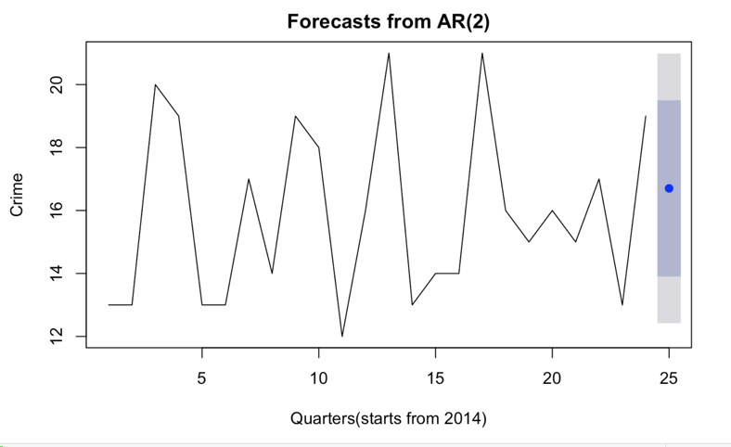
Auto Regression Model (AR)
The crime rate forecasted is 16.70 and there is an 80% probability that the future observation's value will fall between the lower and upper bounds of [13.90,19.50].

Slide 13
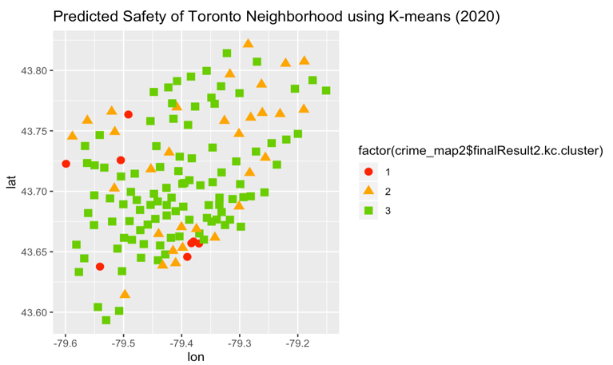
Models Comparison and Prediction
The timeseries (2014-2019) AR model was built and crime rates of different neighbourhoods were forecasted for 2020.
AR shows better performance.
Measurements | RMSE | MAE | MAPE | MASE | Elapsed Time
AR | 2.18 | 1.85 | 11.63 | 0.54 | 0.05
KNN | 3.10 | 2.75 | 17.49 | 1.42 | 0.006
SMA | 17.2 | 3.26 | 0.21 | 0.99 | 0.09

Slide 14
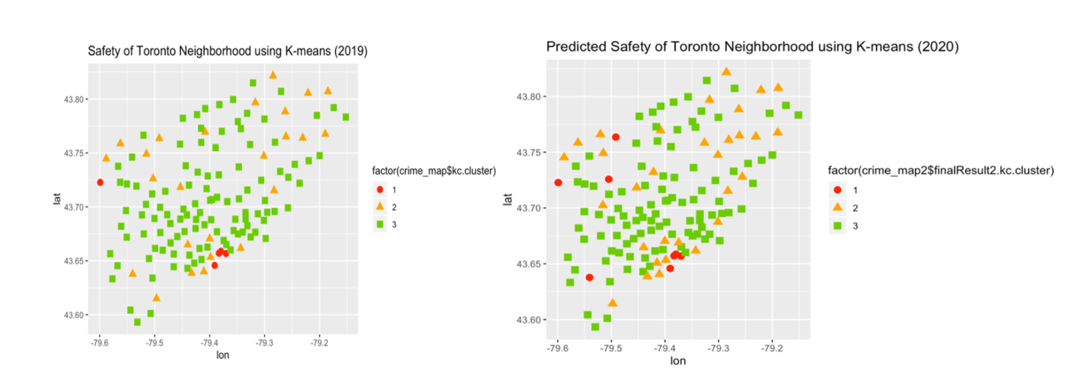
Results
How the crime rate and safety of neighborhoods evolve in near future?
The model predicted that the safest places would be Maple Leaf, Lambton Baby Point, Woodbine-Lumsden and Yonge- st.Clair in 2020.

Slide 15
Conclusion & Recommendation
The Toronto police department has made the Major Crime Indicator (MCI) dataset available to the public. This project analyses the crime rate of Toronto regions based on the MCI data to answer two main questions: the current safety of the city and the projected safety of different regions in future.
One of the main objectives of this research is to provide the user with a simple, compact, and scientific measure of safety based on the MCI data, without the need to constantly browse and compare various crime rates in different areas. PCA and K-means clustering are the techniques that were employed to achieve this goal.
The second goal of this research is to forecast crime rates. Timeseries forecasting using three different regression models were used and accuracy of the models were compared. The AR shows a better accuracy in crime rate timeseries forecasting comparing to the other models. The AR regression model analyses the past crime activities which occurred in Toronto regions and predicts the future crime rate of those regions.
The recommendation to the Toronto police department and the city authorities is to watch neighbourhoods with forecasted high crime rates more in order to decrease the crime rate and improve the safety of the city. Also, publishing these ML results to the public by police department helps the citizens to be more aware of the crimes rates in the area that they live in or work.
Research limitations and future works:
MCI data only provides crime rate since 2014. As more data becomes available, better calibration and forecasting precision can be achieved.
Forecasting methods only consider previous year crime rates. This can be improved by adding more variables such as regions population, employment rate, family income, etc.

Slide 16
Thank You!

